Slide 1
Customer purchasing capabilities
Anwesha Das

Slide 2
Objective
Customer Segmentation is the subdivision of a market into discrete customer groups that share similar characteristics. Customer Segmentation can be a powerful means to identify unsatisfied customer needs. Using the data, companies can then outperform the competition by developing uniquely appealing products and services.

Slide 3
Dataset Description
Custid - identification of Credit Card holder (Categorical)
BALANCE - Balance amount left in customers account to make purchases
BALANCE_FREQUENCY - How frequently the Balance is updated, score between 0 and 1
PURCHASES - Amount of purchases made from account
ONEOFF_PURCHASES - Maximum purchase amount done in one-go
INSTALLMENTS_PURCHASES - Amount of purchase done in instalment
CASH_ADVANCE - Cash in advance given by the user
PURCHASES_FREQUENCY - How frequently the Purchases are being made, score between 0 and 1
ONE OFF PURCHASE FREQUENCY - How frequently Purchases are happening in one-go
PURCHASE INSTALMENTS FREQUENCY - How frequently purchases in instalments are being done
CASH ADVANCE FREQUENCY - How frequently the cash in advance being paid
CASH ADVANCE TRX - Number of Transactions made with "Cash in Advance"
PURCHASES_TRX - Number of purchase transactions made
CREDIT_LIMIT - Limit of Credit Card for user
PAYMENTS - Amount of Payment done by user
MINIMUM_PAYMENTS - Minimum amount of payments made by user
PRC FULL PAYMENT - Percent of full payment paid by user
TENURE - Tenure of credit card service for user

Slide 4
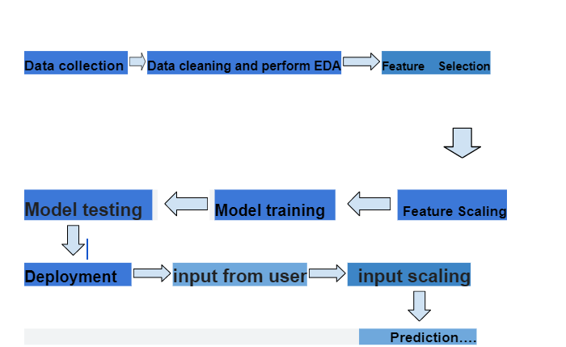
Architecture

Slide 5
Flow of Architecture
Data gathering
source:
https://www.kaggle.com/datasets/arjunbhasin2013/ccdata?select=CC+GENERAL.csv
Data preprocessing :
we cleaned our data by removing null values because they were very less in number.
we apply Min-Max scaling to scale-down data. and we save this model to scale down user input for future purpose.
we use elbow method to find out number of clusters . we saved this model for cluster prediction of user input.
Then we perform principle component analysis because for reducing dimensionality the databases

Slide 6
Model training
we train our data on different unsupervised machine learning algorithms like k-means, DB scan, Hierarchical clustering and we get best performance with k-means clustering.
we use elbow method to find out number of clusters. we saved this model for cluster prediction of user input.

Slide 7
Flask setup for Data Extraction
After saving the model, API building process started using Flask. Web application creation was created here. we have integrated ui with the app by which user can give data on web browser and get the prediction. Whatever the data user will enter and then application will gives the number of group that data belongs.

Slide 8
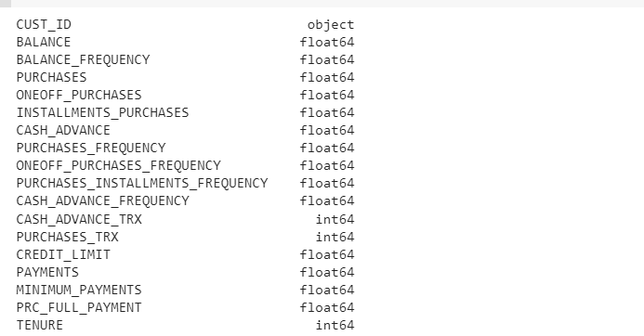
The types of Data in Dataset

Slide 9
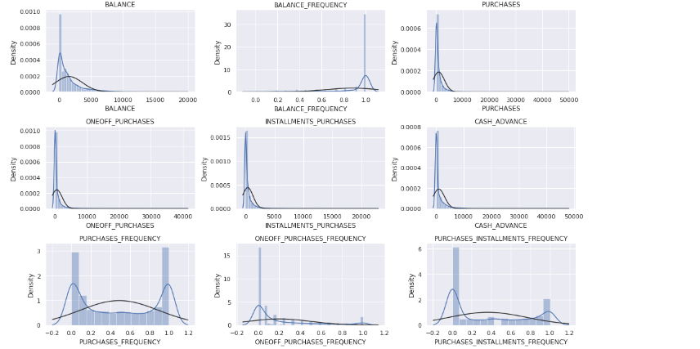
Data observation

Slide 10
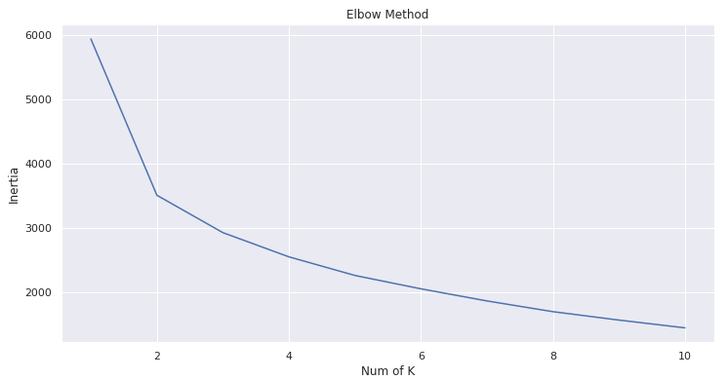
Elbow method

Slide 11
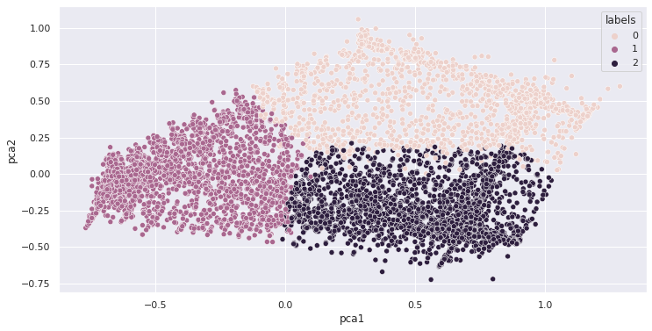
clustering

Slide 12
Metrices
Silhouette Coefficient or silhouette score is a metric used to calculate the goodness of a clustering technique. Its value ranges from -1 to 1.
1: Means clusters are well apart from each other and clearly distinguished.
0: Means clusters are indifferent, or we can say that the distance between clusters is not significant.
-1: Means clusters are assigned in the wrong way.
Silhouette Score = (b-a)/max(a,b)
where
a= average intra-cluster distance i.e the average distance between each point within a cluster.
b= average inter-cluster distance i.e the average distance between all clusters.

Slide 13
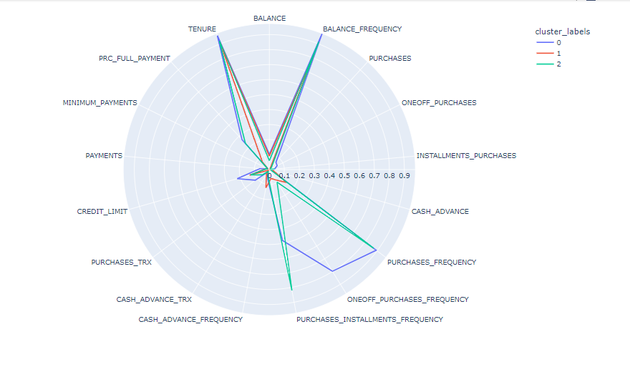
Polar graph

Slide 14
conclusion
0 - cluster - these customers are having High Purchase capability
1 - cluster - As these customer PURCHASE_FREQUENCY is very low. we can say these have Low Purchase capability
2 - cluster - These customer are purchase good on installment, so these are also have High with Installment.

Slide 15
Q&A
Q1) What’s the source of data?
The data for training is taken from kaggle
Q 2) What was the type of data?
The data is the numerical data.
Q 3) What’s the complete flow followed in this Project?
Refer slide 4th for better Understanding

Slide 16
Q&A
4. what is customer segmentation?
customer segmentation means forming groups of customers based on some of the similar features.
5.how logs are managed?
we have a logger which gives logs with respect to every steps of data transformation and predictions.
6.how training was done?
At first we handle the null values and scale our data using minmax scaler, then we use k-means clustering to perform clustering.

Slide 17
Q&A
7.what all techniques were used for data Pre-processing?
1.removing null values.
2.scaling using min-max scaler.
8.How training was done , which all models were used?
for training we use kmeans, DBscan and hierarchical clustering
methods,
kmeans gives us best silhotte score, so we use that for prediction.
9.How Prediction was done?
1.if prediction result is cluster 0,means customers purchasing capability is more.
2.if prediction result is cluster 1,means customer purchasing capability is partial.
3.if prediction result is 2,means customer purchasing capability is less.

Slide 18
Thank you

